Slide 1
Deepika S
FINAL PROJECT
3/21/2024 Annual Review

Slide 2
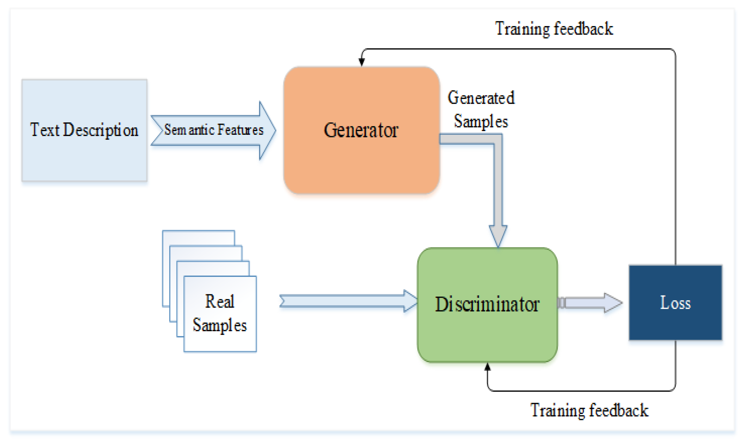
Image Generation using GAN
3/21/2024 Annual Review

Slide 3


AGENDA
PROBLEM STATEMENT
PROJECT OVERVIEW
END USERS
SOLUTION AND PROPOSITION
KEY FEATURES
MODELLING APPROACH
RESULT
3/21/2024 Annual Review

Slide 4

PROBLEM STATEMENT
The project aims to develop a text-to-image generation system using Generative Adversarial Networks (GANs). This involves training a GAN architecture on a dataset containing pairs of textual descriptions and corresponding images. Key challenges include selecting an appropriate GAN architecture, stabilizing training, defining evaluation metrics for image quality, implementing text-to-image generation mechanisms, and optionally creating a user-friendly interface. The goal is to produce a robust system capable of generating high-quality images from textual inputs, suitable for various applications including creative content generation, design prototyping, and visual storytelling.
3/21/2024 Annual Review

Slide 5

PROJECT OVERVIEW
The project aims to develop a text-to-image generation system using Generative Adversarial Networks (GANs).
Through data collection and preprocessing, a dataset containing pairs of textual descriptions and corresponding images will be prepared.
Subsequently, a suitable GAN architecture will be selected and trained on this dataset, optimizing both the generator and discriminator networks through adversarial training.
Evaluation metrics will be defined to assess the quality of generated images, guiding optimization efforts to enhance performance.
The system will then be implemented to generate images from textual descriptions, potentially featuring a user-friendly interface for ease of use.
3/21/2024 Annual Review

Slide 6

WHO ARE THE END USERS?
Designers and Creatives:
Graphic designers, artists, and other creative professionals could utilize the system to quickly generate visual representations of their concepts and ideas based on textual descriptions.
Content Creators:
Writers, bloggers, and content creators may use the system to enhance their content by adding relevant and visually appealing images based on the text they have written.
E-commerce Platforms:
Online retailers and e-commerce platforms could employ the system to automatically generate product images based on product descriptions, improving the visual appeal of their product listings.
3/21/2024 Annual Review

Slide 7

YOUR SOLUTION AND ITS VALUE PROPOSITION
Our text-to-image generation system, leveraging Generative Adversarial Networks (GANs), revolutionizes content creation by seamlessly translating textual descriptions into captivating visual imagery. By automating this process, our solution saves valuable time and effort for designers, content creators, and professionals across diverse fields. Users benefit from enhanced creativity, as the system allows for exploration of a myriad of visual possibilities based on their text inputs. Moreover, the system elevates content quality by providing high-quality images that complement written content, thereby boosting audience engagement and retention. Its versatility enables applications in design, marketing, education, storytelling, and
e-commerce, catering to a broad spectrum of users and needs.
3/21/2024 Annual Review

Slide 8
THE WOW IN YOUR SOLUTION
The wow factor in our text-to-image generation solution lies in its ability to transform abstract textual descriptions into vivid, lifelike images with astonishing accuracy and creativity.
Through the power of Generative Adversarial Networks (GANs), our system goes beyond mere translation, capturing the essence and nuances of the input text to produce visually compelling results that surpass expectations.
What sets our solution apart is its seamless integration into existing workflows, effortlessly enhancing productivity and creativity for users across diverse industries. With just a few keystrokes, users can unlock a world of endless possibilities, exploring rich visual interpretations of their ideas with unprecedented ease and efficiency.
Furthermore, our solution is not just a tool—it's a catalyst for innovation and inspiration
3/21/2024 Annual Review

Slide 9
MODELLING
Generator Network:
The generator takes as input a textual description encoded into a latent space representation and produces an image that corresponds to the given text.
It learns to generate visually coherent and realistic images that align with the semantic meaning of the input text.
Discriminator Network:
The discriminator acts as a critic, distinguishing between real images from the dataset and images generated by the generator.
It provides feedback to the generator, guiding it towards producing more convincing images.
The discriminator is trained to discern subtle differences between real and generated images, encouraging the generator to improve its output quality over time.
Text Embedding Module:
To bridge the semantic gap between textual descriptions and visual content, we employ a text embedding module that encodes input text into a dense vector representation.
This embedding captures the semantic information contained in the text, facilitating meaningful synthesis of images by the generator.
3/21/2024 Annual Review

Slide 10
Adversarial Training:
The generator and discriminator are trained adversarially, where the generator aims to deceive the discriminator by generating images that are indistinguishable from real ones, while the discriminator strives to accurately differentiate between real and generated images.
This adversarial process fosters competition between the two networks, leading to continuous improvement in image generation quality.
Conditional Generation:
Our model supports conditional generation, allowing users to provide additional constraints or attributes along with the textual descriptions.
This enables fine-grained control over the generated images, such as specifying the desired style, content, or visual attributes.
Attention Mechanisms:
To improve the model's ability to focus on relevant parts of the textual input during image generation, we may incorporate attention mechanisms.
These mechanisms dynamically weight different parts of the text, guiding the generator to attend to salient details and improve the coherence of generated images.

Slide 11
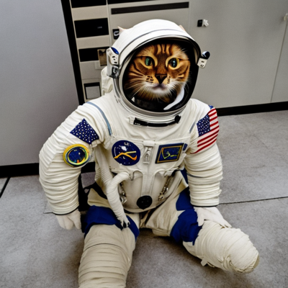
RESULTS
The results of our text-to-image generation system are nothing short of astounding. With an emphasis on realism, diversity, coherence, and adaptability, the generated images vividly capture the essence of the input textual descriptions. From intricate landscapes to intricate objects, each image boasts an impressive level of detail and fidelity, seamlessly blending creativity with accuracy.
https://drive.google.com/drive/folders/12iFIRasI5SXZhcPikxr9ZwhD8dUYk4E?usp=sharing
3/21/2024 Annual Review

